Slide 1


https://www.freepik.com/free-photos-vectors/cartoon-parking-lot
Parking Lot System
Group 3 Yanlu He

Slide 2
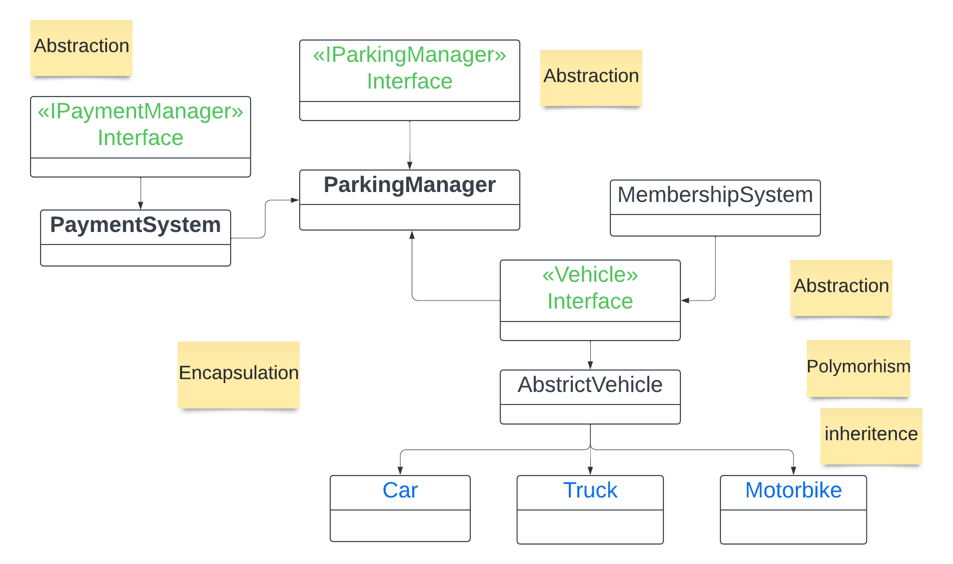

Slide 3
Model
Controller
View
Parking Manager
Payment System
Manager Controller
Customer Controller
Manager View
Customer View

Slide 4
Extensions ...
Flexible,Resuable ...

Slide 5
Reference:
[1] Cover Picture: https://www.dreamstime.com/illustration/cartoon-parking-lot.html
[2] “Best Practice of OOP”, Oct. 30, 2023, https://www.geeksforgeeks.org/best-practices-of-object-oriented-programming-oop/
[3] Vertabelo Team, “Constructing a Data Model for a Parking Lot Management System”, Dec. 5, 2017, https://vertabelo.com/blog/constructing-a-data-model-for-a-parking-lot-management-system/

